Slide 1
Osher Lifelong Learning Institute, Summer 2025
The Economics of Public Policy Issues
Northwestern University
Host: Geoffrey Woglom
Director, National Economic Education Delegation

Slide 2
National Economic Education Delegation
Vision
  One day, the public discussion of policy issues will be grounded in an accurate perception of the underlying economic principles and data.
Mission
  NEED unites the skills and knowledge of a vast network of professional economists to promote understanding of the economics of policy issues in the United States.
NEED Presentations
  Are nonpartisan and intended to reflect the consensus of the economics profession.

Slide 3
Who Are We?
Honorary Board: 54 members
  2 Fed Chairs: Janet Yellen, Ben Bernanke
  6 Chairs Council of Economic Advisers
    Furman (D), Rosen (R), Bernanke (R), Yellen (D), Tyson (D), Goolsbee (D)
  3 Nobel Prize Winners
    Akerlof, Smith, Maskin
Delegates: 652+ members
  At all levels of academia and some in government service
  All have a Ph.D. in economics
  Crowdsource slide decks
  Give presentations
Global Partners: 48 Ph.D. Economists
  Aid in slide deck development

Slide 4
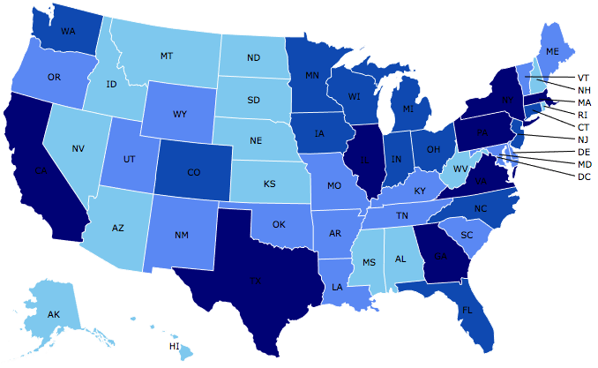
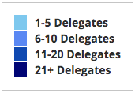
Where Are We?

Slide 5
Available NEED Topics Include:
US Economy
Healthcare Economics
Climate Change
Economic Inequality
Economic Mobility
Trade and Globalization
Minimum Wages
Immigration Economics
Housing Policy
Federal Budgets
Federal Debt
Black-White Wealth Gap
Autonomous Vehicles
US Social Policy

Slide 6
Course Outline
The Economics of Public Policy Issues
  Week 1 (7/8): Economic Update (including tariffs) (Geoffrey Woglom, Amherst College)
  Week 2 (7/15): Climate Change Economics (Sarah Jacobson, Williams College)
  Week 3 (7/22) The Economics of the Minimum Wage (Veronika Dolar Pace University)
  Week 4 (7/29): Cryptocurrencies (Joan Nix Queens College (CUNY))
  Week 5 (8/5): Saving Social Security (Jon Haveman, Exec Director, NEED)
  Week 6 (8/12): Federal Debt and Deficits (Geoffrey Woglom, Amherst College)

Slide 7
How Economists Decide How Much to Fight
Climate Change: Cost Benefit Analysis
Abating greenhouse gas emissions is costly…
… but without action, climate change damages are even more costly.
Goal is not zero emissions, but efficient level that achieves a balance.
Expected costs of reducing emissions
Expected damages from allowing climate change

Slide 8
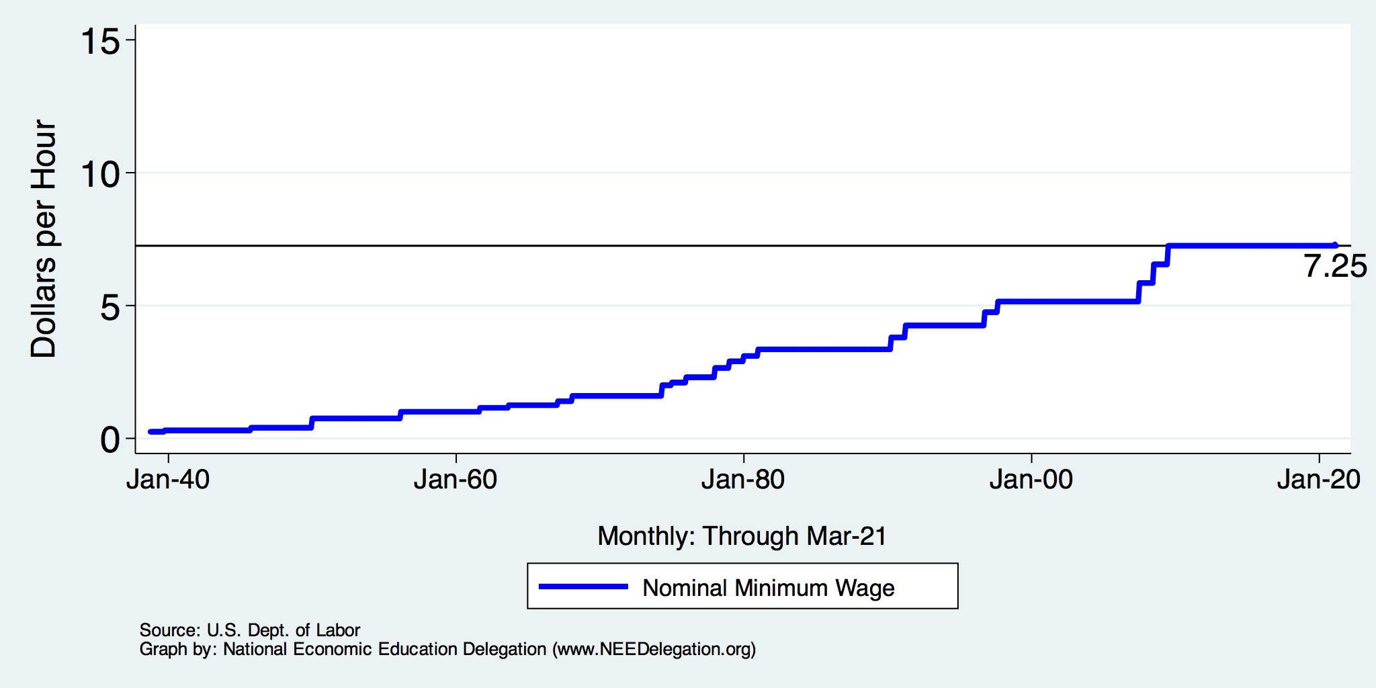
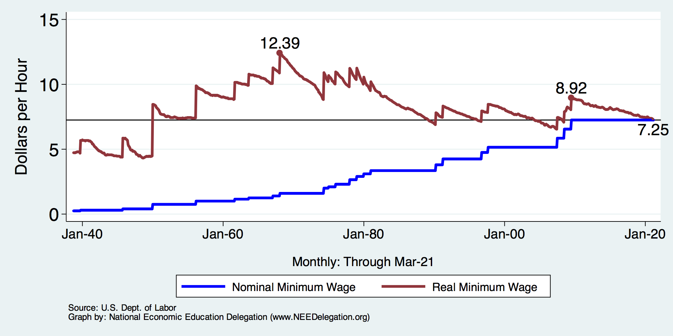
History of the Minimum Wage

Slide 9
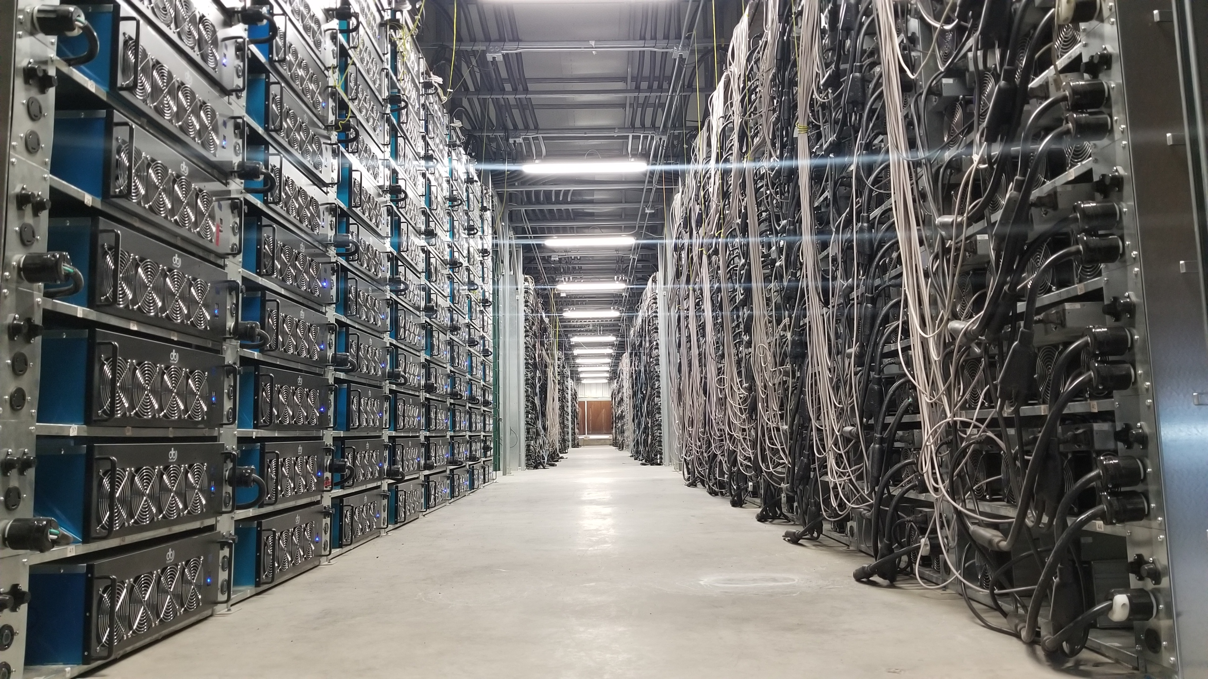
Bitcoin mine

Slide 10
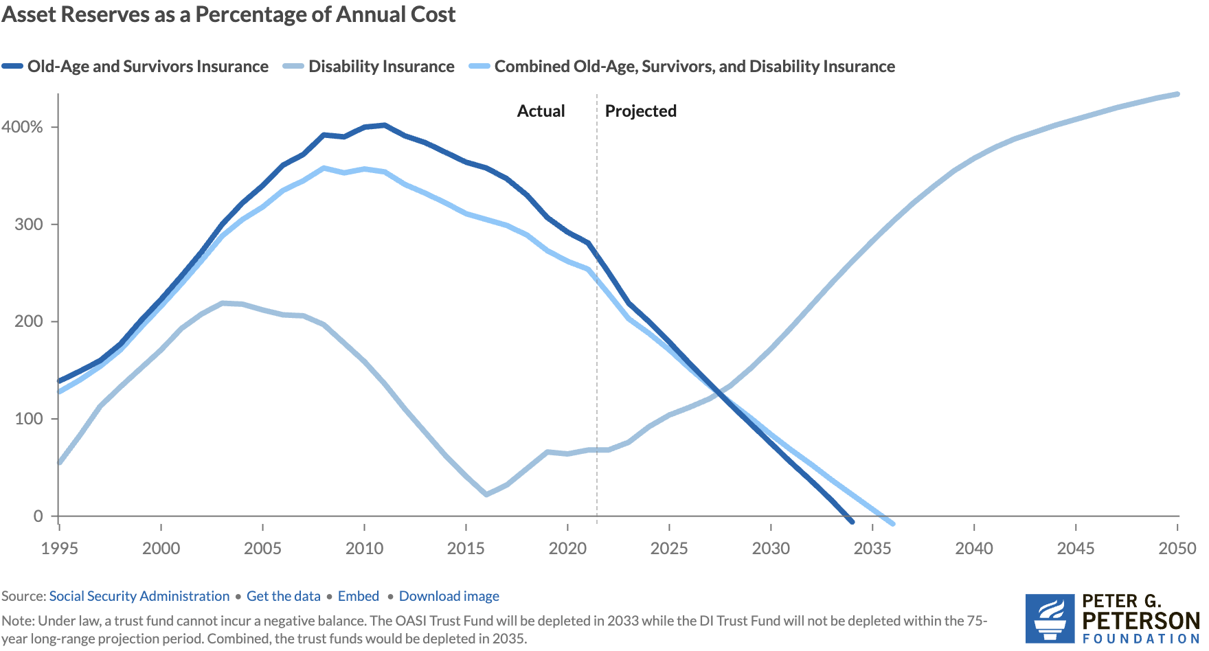
Trust Finds Are Running Out
Source: https://www.pgpf.org/article/social-security-faces-serious-financial-shortfalls-and-other-takeaways-from-the-trustees-report/

Slide 11
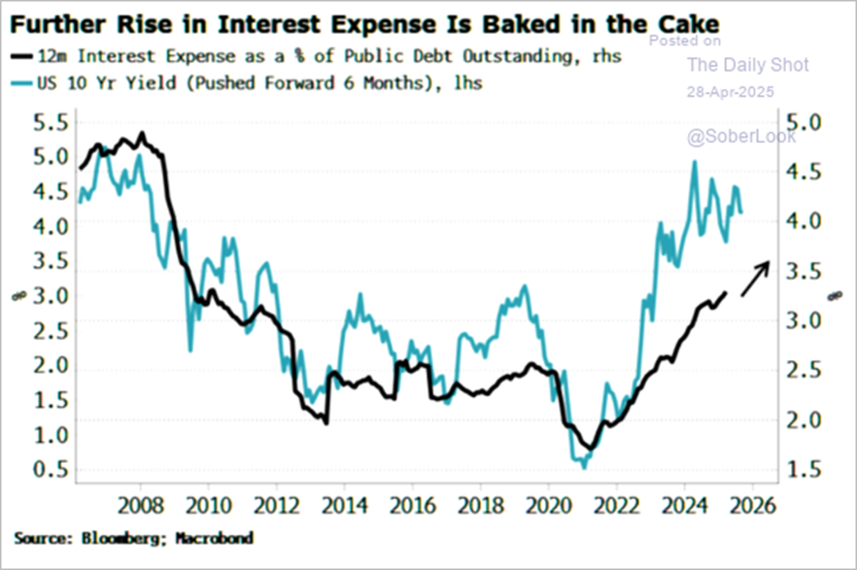
The Future of Interest on the Debt?

Slide 12
Submitting Questions
Submit questions in the chat. I will try to address questions as they come up.
We will do a verbal Q&A once the material has been presented.
Slides will be available from the NEED website tonight https://needecon.org/delivered_presentations.php.
My macro site: https://sites.google.com/view/macro-current-issues/economic-update

Slide 13
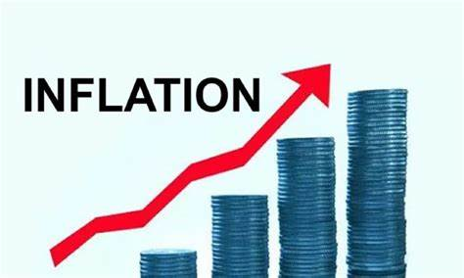

US Economy: Update
Geoffrey Woglom,
Professor of Economics
Amherst College, emeritus
July 8, 2025

Slide 14
Outline for the Talk
Quick Overview of State of the Economy
Tariffs and Trade Balances:
  Definitions & Econ 101 analysis of tariffs
  Latest Developments
  Facts about US Trade Balances
  Effects of Tariffs
  Some Ominous Signs
  (The “Big Beautiful Bill” will be covered in the Debt and Deficit Talk)

Slide 15
Gross Domestic Product: 2025Q1 = $30.0 tr
$31.2
Less Imports
-$4.5
Plus Exports
+$3.3
Equals GDP
$30.0

Slide 16
Basic GDP Accounting
Trade Deficit is when imports (IM) exceed exports (EX)
Trade Deficits arise when we spend domestically more than we produce
Y - C - I – G = -IM + EX, $30.0-$31.2=-$1.2
Useful definition Y – C – G is “National Saving” the sum of private saving less the government deficit. Rearranging
(Y – C - G )– I = National Saving less Investment = -IM + EX = Trade Deficit
We spend more than we produce when national saving isn’t sufficient to finance our investment, so we borrow from abroad.
Trade Deficit = National Saving less Investment.
Key Takeaway: Trade Deficits are Associated with an imbalance of national saving and investment

Slide 17
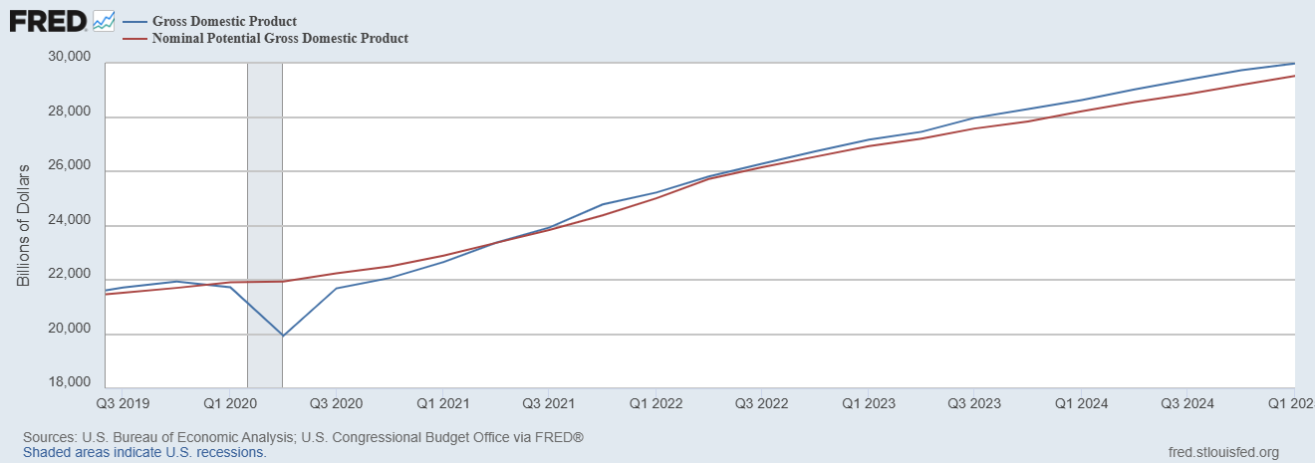
GDP and ‘Potential’ during the Recovery
Grey bar indicates recessions
Source: Fred, St Louis Fed

Slide 18
What is a Recession?
Defined by the National Bureau of Economic Research (NBER)
“The NBER's definition emphasizes that a recession involves a significant decline in economic activity that is spread across the economy and lasts more than a few months.”
Popular Rule of Thumb: Two or more, consecutive quarters where Real GDP falls. (Doesn’t always work!)
Recessions are caused by a drop in total spending (remember the consumer).

Slide 19
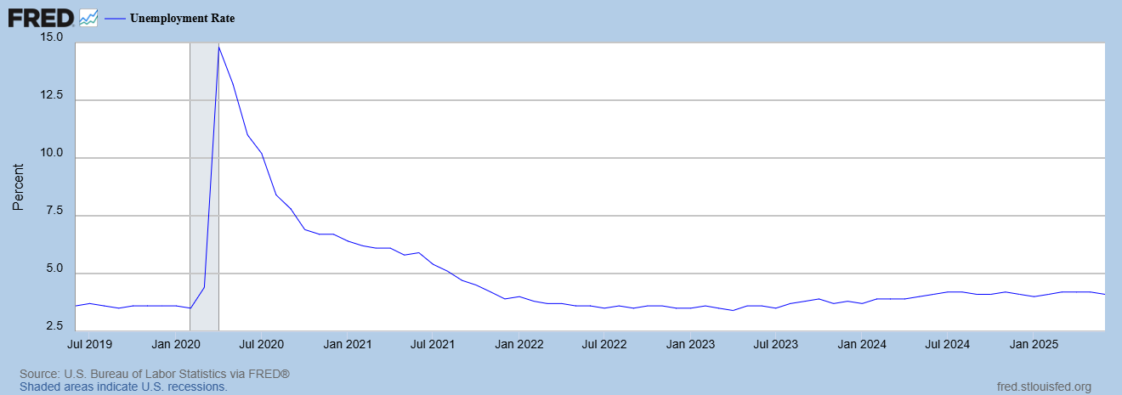
Unemployment is Near Record Lows
But, so far no signs of tariffs effect on unemployment

Slide 20
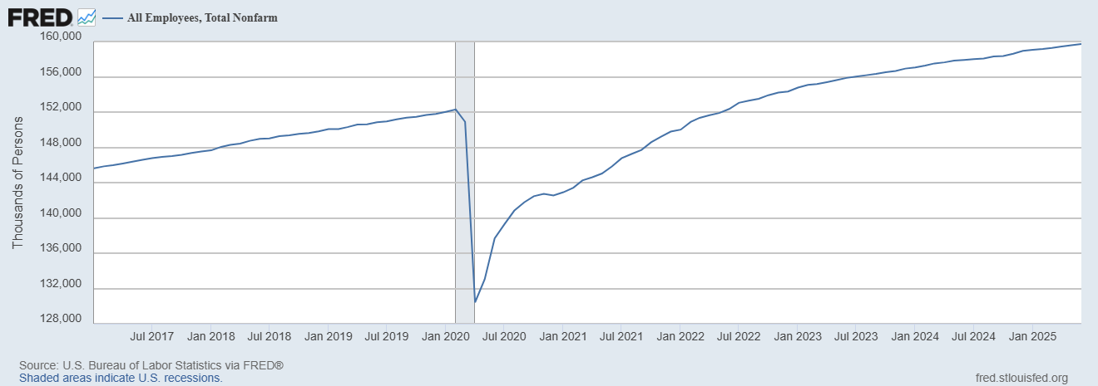
Where Have All the Workers Gone?
Source: Fred, St Louis Fed

Slide 21
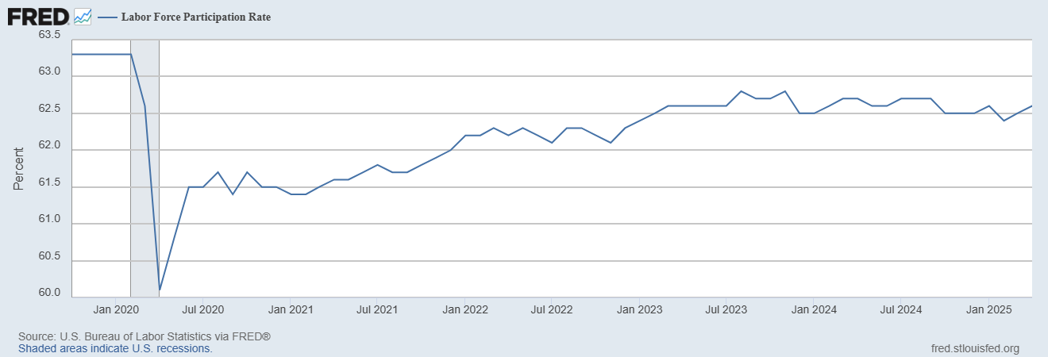
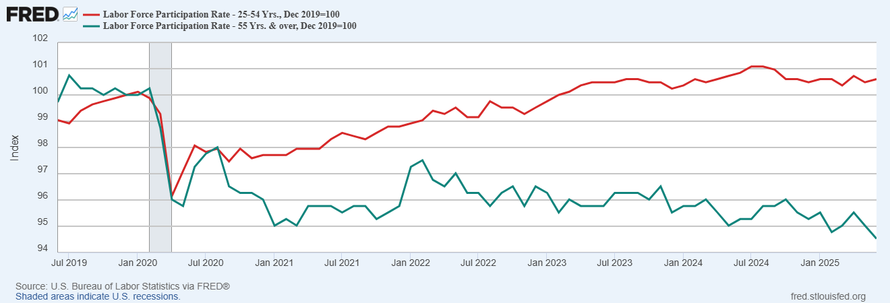
The Aging of the Labor Force
Notes:
F

Slide 22
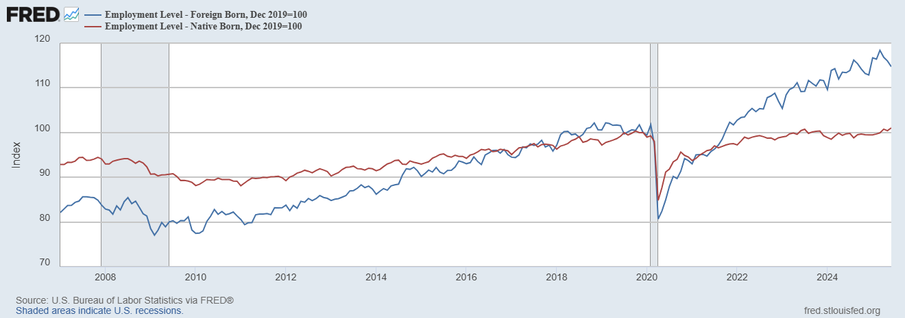
Supplemented by Foreign Born Workers
Between 12/19 and 6/25
NB employment rose by 1500k
FB employment rose by 4000k
Since March FB employment
fell by 1000k

Slide 23
Overall Good News on the Real Side
GDP is very close to its potential.
The labor market as measured by the unemployment rate is fully recovered.
But there is also a nominal side: interest rates, asset prices, inflation and wages.
News is pretty good, but progress on inflation seems to have stalled.

Slide 24
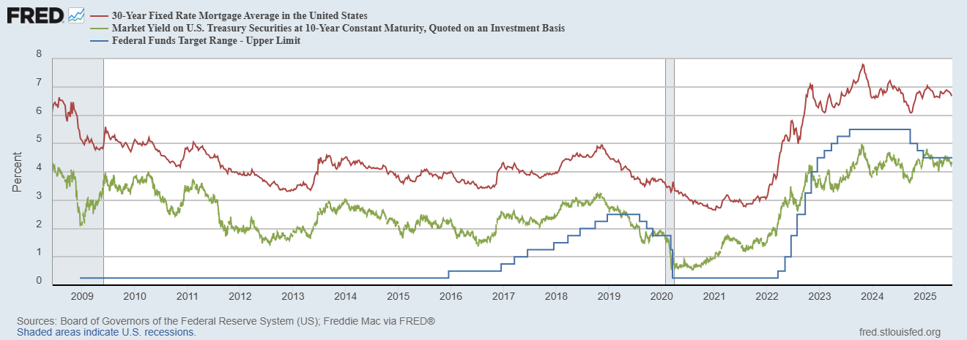
Interest Rates: Era of Falling Rates Over?
Notes:
Fed policy rate 4.5 to 4.25. Concerns with inflation

Slide 25
National Housing Market
https://www.zillow.com/research/data/

Slide 26
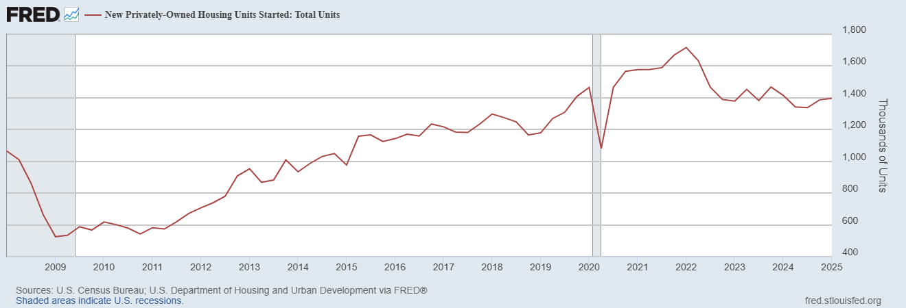
Housing Construction is Slowing?

Slide 27
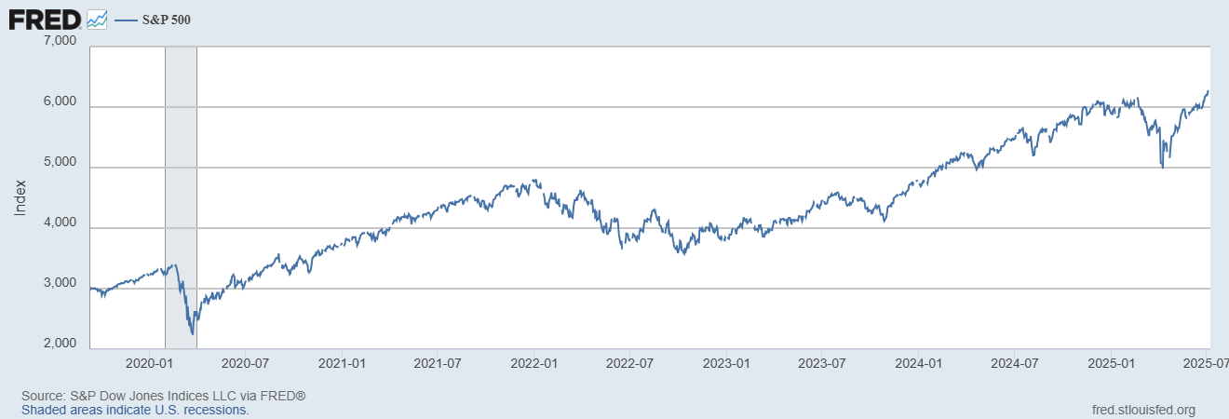
Stock Prices: Tariffs; What Tariffs?
Notes:
Since the end of 2021, lost almost 15%

Slide 28
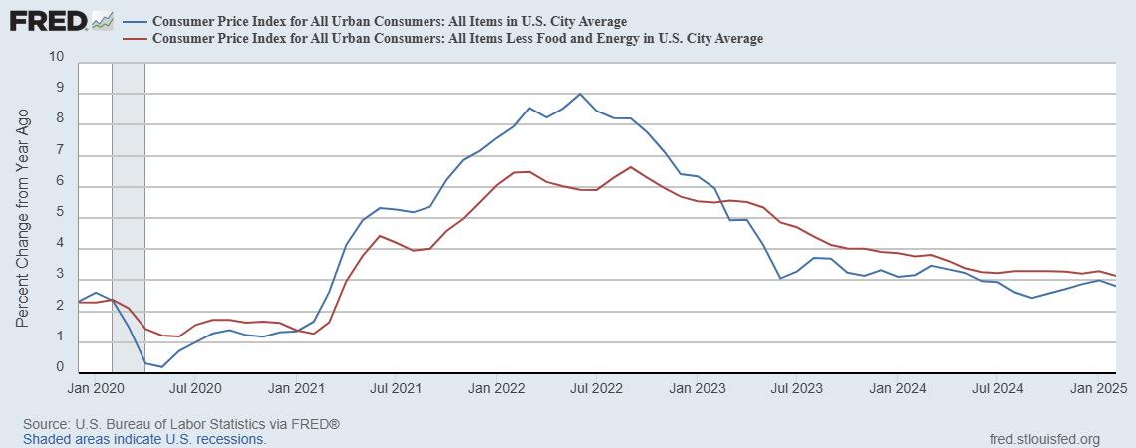
Inflation during the Recovery (CPI)
Notes:
August CPI yoy 8.3% down from 8.5 and Core 6.3 up from 6.3 in JUly

Slide 29
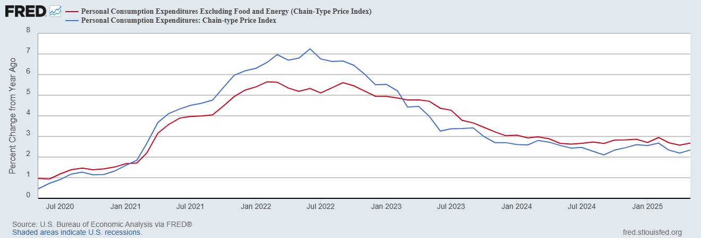
Fed’s Measure (PCE)
Inflation Accelerates 3/2021
Fed Doesn’t React until 3/2022
Progress slows Spring 2024
But, so far no signs of tariffs effect on inflation

Slide 30
CPI vs. PCE: Differences
CPI tends typically to be 0.3 pct point higher
May:
CPI, 2.4%
PCE, 2.3%
Core CPI, 2.8%
Core PCE, 2.7%.
https://www.morningstar.com/markets/whats-difference-between-cpi-pce

Slide 31
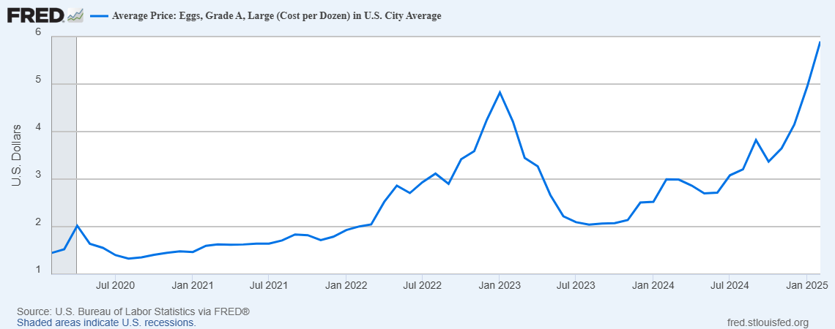
Uses of Inflation Measures
Two Reasons for Measuring Recent Inflation:
What has happened to the Cost of Living?
What is likely to happen to inflation over the next 12-18 months?

Slide 32
Two Measures of the Cost of Housing

Slide 33
Wages Have Finally Caught Up to Inflation
Federal Reserve of Atlanta, “Wage Tracker” and BLS
Notes:
But, note that low wage workers are doing relatively the best

Slide 34
International Comparisons
IMF, World Economic Outlook, 4/2025

Slide 35
The State of the Economy & Effects of Policy
In terms of output and employment the economy is fully recovered
Inflation is still a bit elevated, but close to Fed target.
Policy Effects
Biden Fiscal Stimulus led to a rapid recovery, but may have been too big.
Fed reacted too little and too late and let inflation get out of control.
But since Spring 2023, Fed has been close to perfect.
But Dark Clouds Are Looming on the Horizon,

Slide 36
Consumers Are Not Happy (2/3rds of GDP)

Slide 37
They Are Worried about Inflation

Slide 38
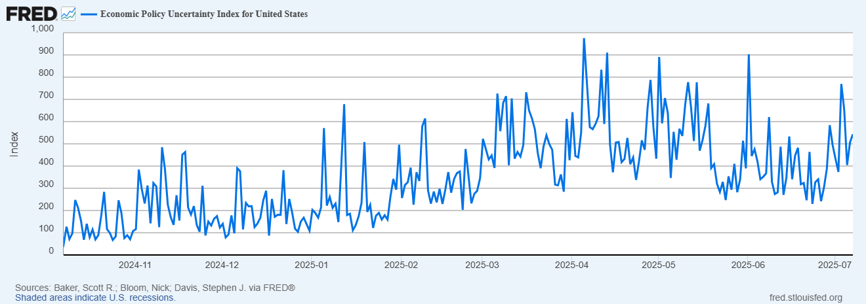
And, Also Concerned about Policy Uncertainty

Slide 39
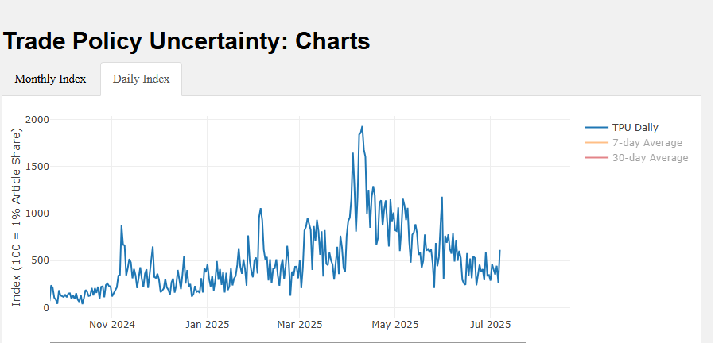
Where are Tariffs Going?
Inauguration
“Liberation Day”
“Data downloaded from https://www.matteoiacoviello.com/tpu.htm on May, 14,2025).

Slide 40
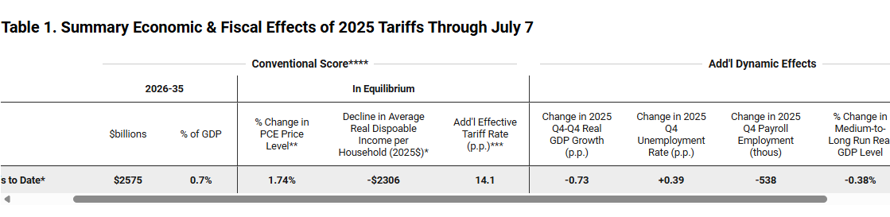
StagFlation and the Fed’s Dilemma
The Dilemma: To fight inflation the Fed needs to raise interest rates
To fight unemployment the Fed needs to lower interest rates
https://budgetlab.yale.edu/research/state-us-tariffs-may-23-2025

Slide 41
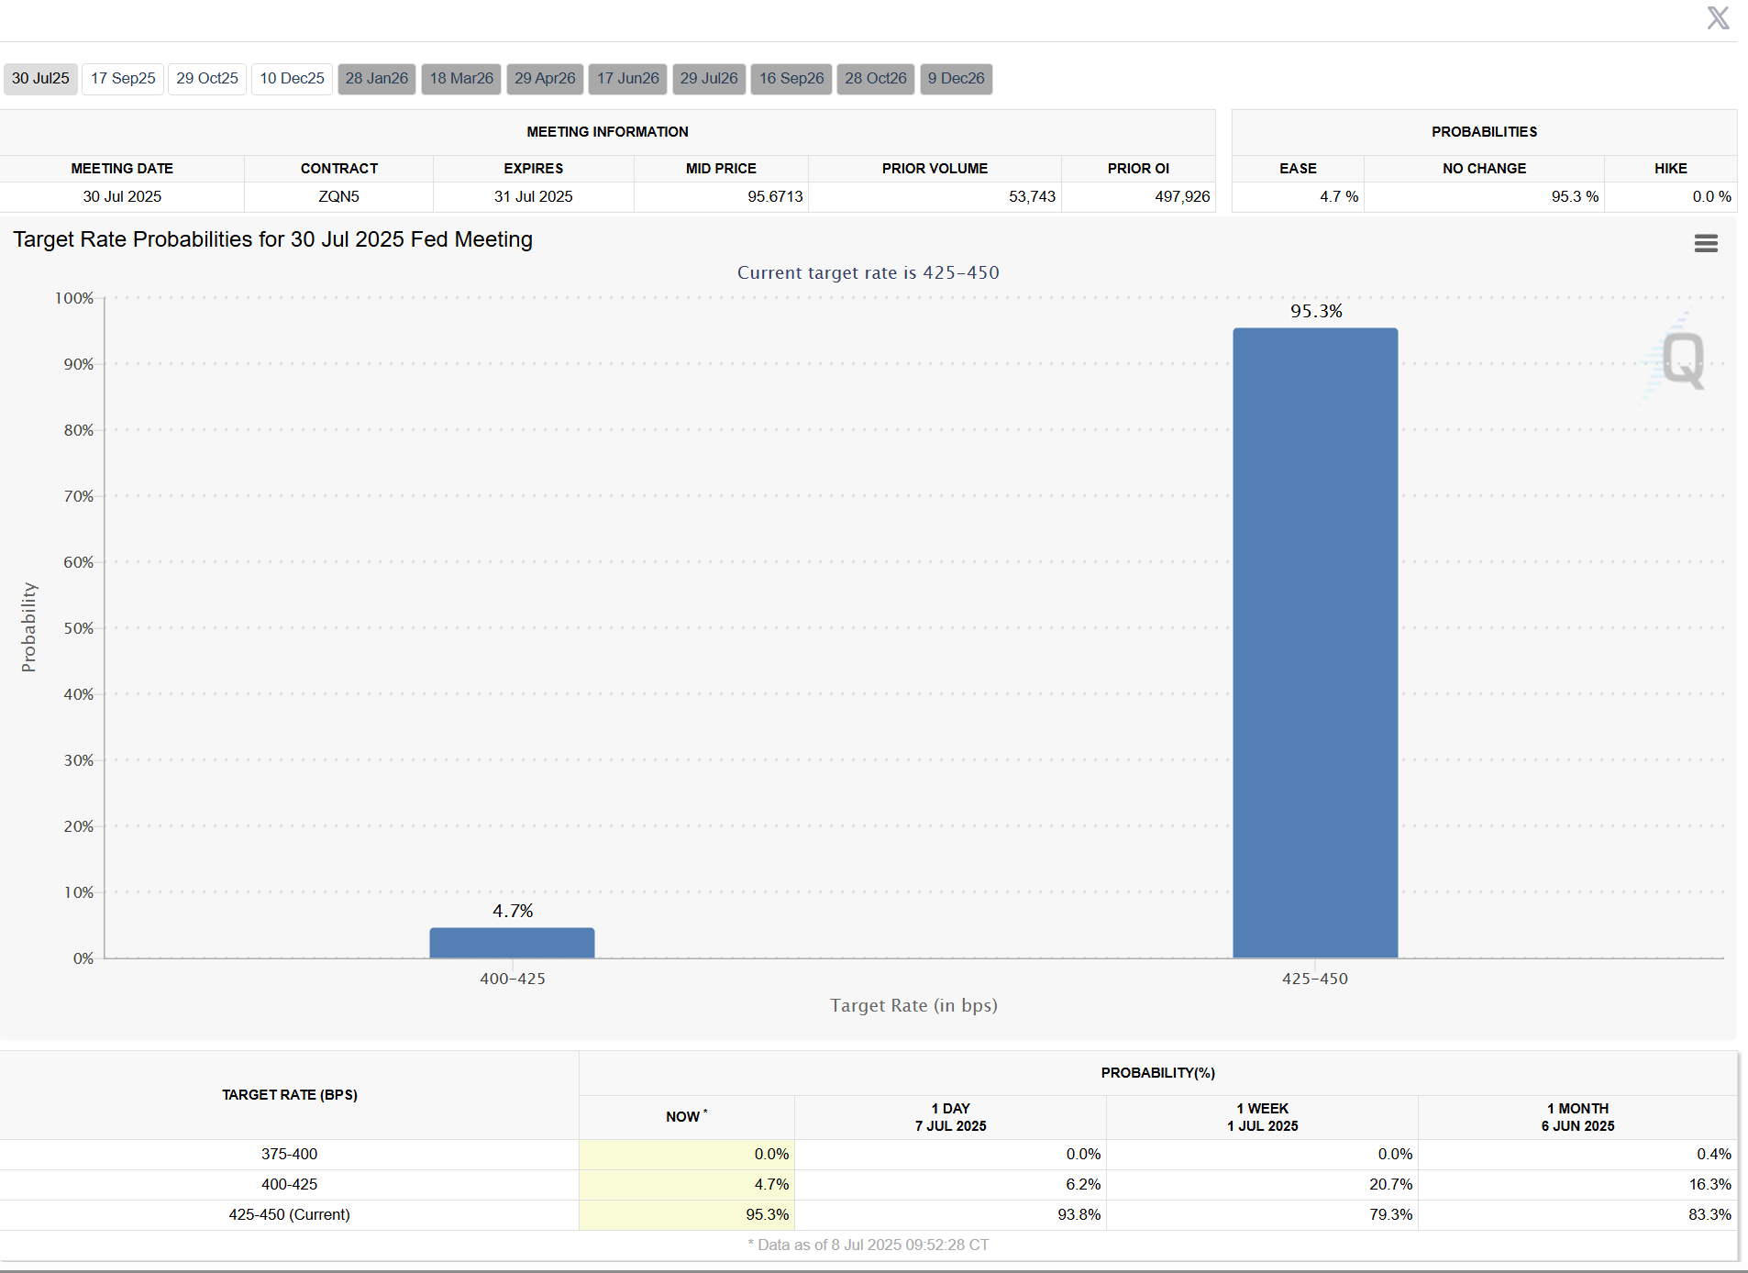
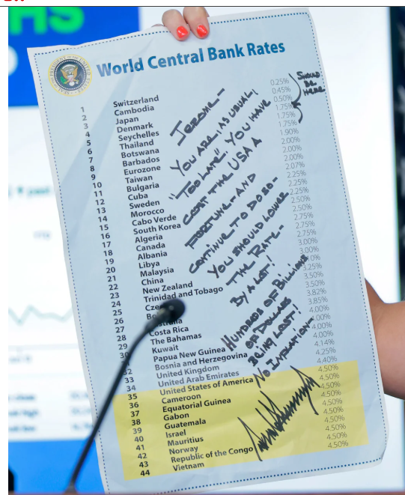
What Will the Fed Do?
https://www.cmegroup.com/markets/interest-rates/cme-fedwatch-tool.html

Slide 42
A Brief Primer on Tariffs
Tariffs are a sales tax on imported goods, collected from importers
The burden of the tariff in general falls on buyers of imports (consumers and firms) to the extent of higher prices and on the foreign country.
Economist don’t like tariffs in general because they “reduce the gains from trade.”
  More efficient utilization of global resources: “Why doesn’t Patrick Mahomes mow his own lawn?”
  Economies of scale for producing for large markets: Lesotho and blue jeans.
Gains to Trade Taken to a New Level with Global supply chains

Slide 43
Possible Economic Arguments for Tariffs
Possible arguments for tariffs
  National Defense – strategic resource. Do we need the capacity to make our own computer chips, just in case?
  “Infant” Industry
  Temporary strategy to reduce foreign tariffs

Slide 44
As of July 7th

Slide 45
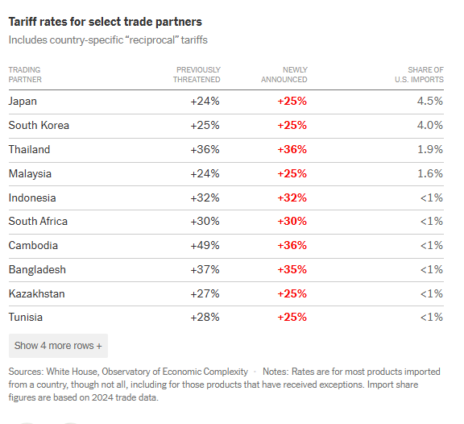
Getting Tough or Getting Taco?
https://www.nytimes.com/2025/07/07/business/trump-tariffs-trade-deals-august-1.html

Slide 46
History of US Average Effective Tariff Rates
Smoot-Hawley
https://budgetlab.yale.edu/research/state-us-tariffs-april-15-2025

Slide 47
Doesn’t Congress Set Taxes, including Tariffs?
Yes, but Congress has delegated the authority to raise tariffs 4 times
  1930; If a foreign country discriminates against US commerce, tariff rate upt to 50%
  1962: If imports threaten national security following an investigation by the Secretary of Commerce
  1974: If the US International Trade Commission finds that a surge in imports is harming domestic industries up to 50%.
  1977: President declares a national emergency due to “an unusual and extraordinary threat” originating outside the US.
President Trump has been claiming tariff authority from 2&4., but is being challenged in courts.

Slide 48
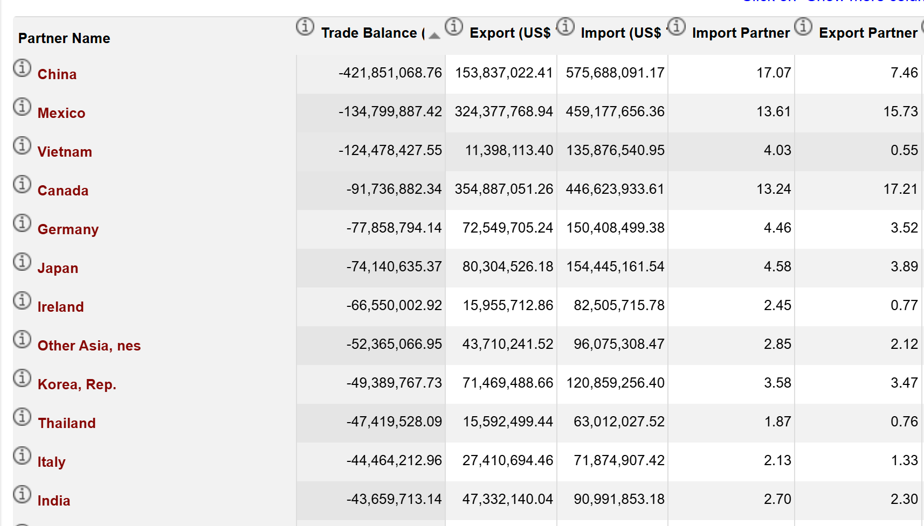
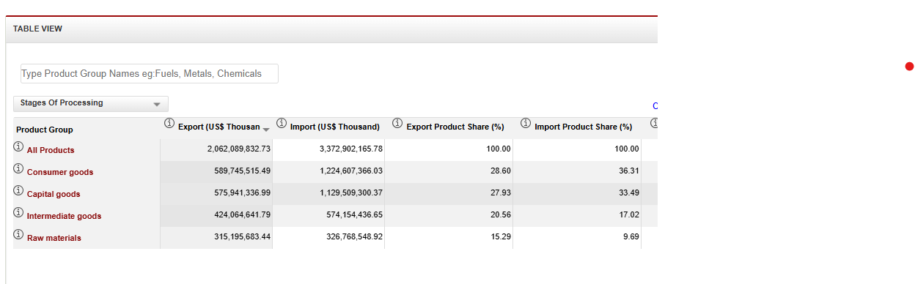
US Trade Balance & Types of Imports
Imports are mostly production inputs, not consumer goods
https://wits.worldbank.org/CountryProfile/en/Country/USA/Year/2022/TradeFlow/EXPIMP/Partner/by-region

Slide 49
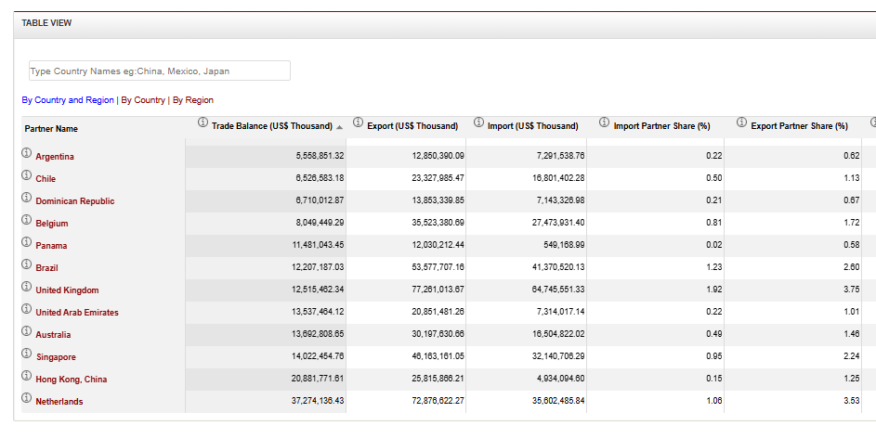
Countries for which US runs a
Bilateral Trade Surplus

Slide 50
Economic Significance of Trade Deficits
Bilateral trade deficits are not necessarily a sign of a problem
  Patrick Mahomes and the teenager who mows his lawn.
  Lesotho and the US,
Total Trade Deficits can be good or bad
  Is the foreign borrowing being used for productive investments.

Slide 51
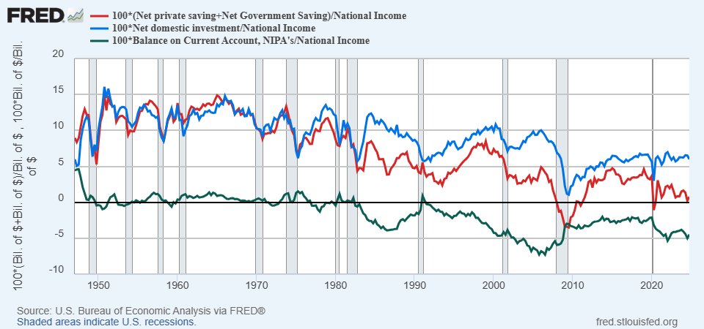
US: Since 2000s, Good or Bad?

Slide 52
What about the China Shock?
2000 Economist View of the Effects of Increasing Trade
  Free Trade leads to more gains than losses
  Trade was not the major cause of the decline in manufacturing employment nor in the rise of inequality.
  Increasing trade would affect low skilled wages generally and not by trade-exposed workers speciifically.
  Worker mobility was high.
Given 4, increasing trade should provide gains for most.
https://www.nber.org/system/files/working_papers/w21906/w21906.pdf

Slide 53
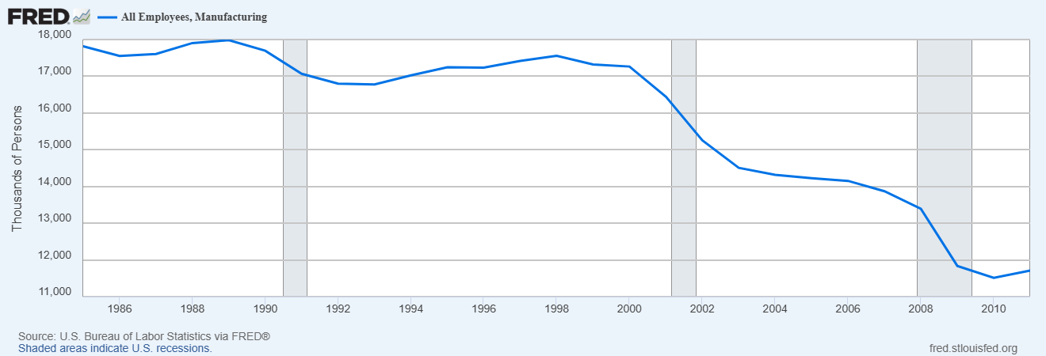
The China Shock
China Joins WTO in December of 2001

Slide 54
Autor et. al.’s Conclusion
While these results do not at all suggest that international trade is in the aggregate harmful to nations-indeed, China's unprecedented rise from widespread poverty bears testimony to trade's transformative economic power-it makes clear that trade not only has benefits but also significant costs. These include distributional costs, which theory has long recognized, and adjustment costs, which the literature has tended to downplay.
China shock showed that a rapid influx of imports can cause harm that is geographically concentrated and long lasting to communities with import competing industries.

Slide 55
Tariffs and Trade Deficits
Remember, Trade Deficits are the mirror image of investment greater than national saving.
For the trade deficit to fall either national saving must rise and/or investment must fall (not what we want).
For national saving to rise
  Households and businesses must save more, or
  The government deficit must fall.

Slide 56
So, What Do Tariffs Do?
Tariffs do increase national saving by raising revenue, but also
Decrease the demand for the goods subject to the tariff, which
Increases the value of the dollar, thereby
  Lowering our exports as domestic goods cost more to foreigners.
  Offsets some but not all of the effect of the tariff on total imports, as non-tariffed imports are cheaper.
Net Effect (first approximation)
  Exports fall, Total Imports fall, and the change in the trade balance is solely due to tariff revenues reducing the government deficit.
  Composition of imports changes while the relative share of non-tariffed imports rises.

Slide 57
Distributional Effects
Poor hurt relatively the most, “regressive” tax
https://budgetlab.yale.edu/research/state-us-tariffs-july-7-2025

Slide 58
Putting Tariff, Tax & Spending Policies Together
Yale Budget Lab estimates for 10 years:
  July 7th tariffs will raise $2.6 trillion
  One Big Beautiful Bill will raise deficits by $3.0 trillion
Net effect
  Larger Deficits
  Worsening Trade Deficit!

Slide 59
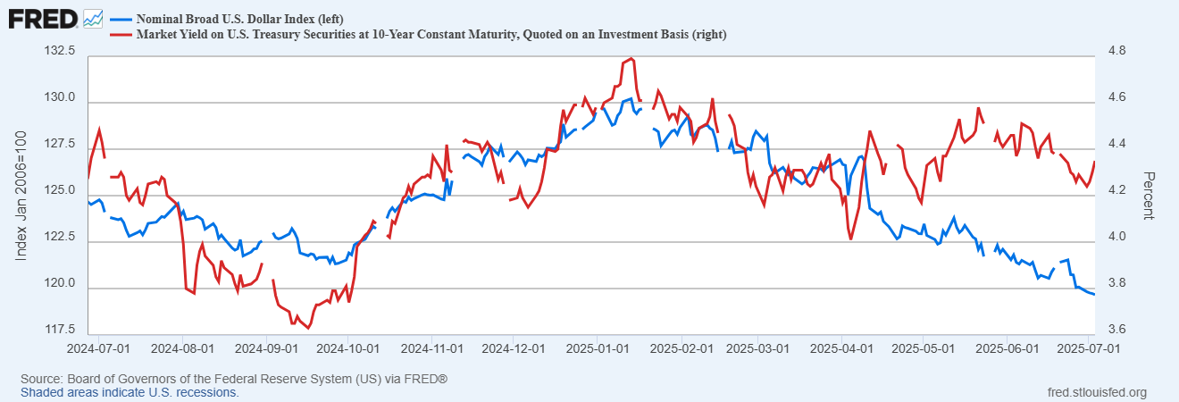
But, There is More!

Slide 60
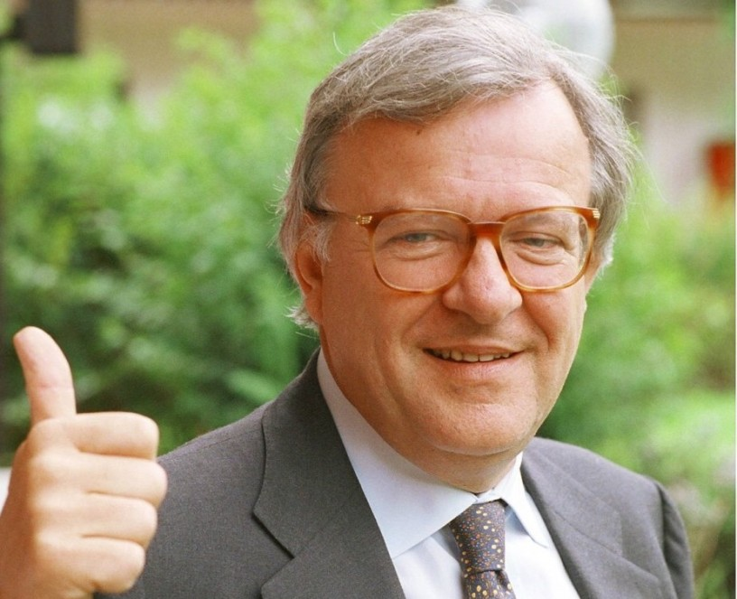
Economists’ Famous Quotes
Crises take longer to arrive than you can possibly imagine,
But when they do come, they happen faster than you can possibly imagine.
Rudiger Dornbusch in a happier moment

Slide 61
My Google Site
https://sites.google.com/view/macro-current-issues/economic-update

Slide 62
Next Week: Climate Change Economics
Abating greenhouse gas emissions is costly…
… but without action, climate change damages are even more costly.
Goal is not zero emissions, but efficient level that achieves a balance.
Expected costs of reducing emissions
Expected damages from allowing climate change

Slide 63
Let’s Hear from You!
Geoffrey Woglom grwoglom@amherst.edu
Contact NEED: Info@NEEDEcon.org
Support NEED: www.NEEDEcon.org/donate.php

